Slide 1
UI/UX Principles
Lab 4

Slide 2
Agenda
Boolean and Variants
Organizing Project

Slide 3
Boolean and Variants

Slide 4
Boolean and Variants
What Are Boolean and Variants in Figma?
In Figma, Boolean properties and Variants are powerful tools for creating flexible and reusable design components.
Boolean Properties
Boolean properties allow you to toggle the visibility of certain elements within a component. For example, if you have a button component that can either include or exclude an icon, you can use a Boolean property to control the icons visibility. This helps in reducing the number of variants you need to create and keeps your design system more manageable
Variants
Variants are used to create different states or versions of a component. Instead of creating multiple separate components for each state (like a button in its default, hover, and active states), you can create a single component with multiple variants. This makes it easier to manage and update your components. You can arrange these variants in any way you choose within the component set

Slide 5
Boolean and Variants
Why Are Boolean and Variants Important?
Boolean Properties
Simplify Component Management: By using Boolean properties, you can control the visibility of elements within a component without creating multiple versions. This reduces the complexity of your design system.
Increase Flexibility: They allow you to easily toggle features on and off, making it simpler to adapt components to different use cases.
Variants
Streamline Design Updates: Variants enable you to manage different states of a component (like default, hover, and active) within a single component set. This makes it easier to update and maintain consistency across your design.
Enhance Reusability: With variants, you can create a comprehensive set of component states that can be reused across different parts of your project, ensuring a cohesive design language.
Overall, these features help you create more organized, scalable, and maintainable design systems.

Slide 6
How to Create Boolean and Variants in Figma
Creating Boolean properties and Variants in Figma can greatly enhance your design workflow. Here’s a step-by-step guide for both:
Creating Boolean Properties
Select Your Component: Click on the component you want to add a Boolean property to.
Add Property: In the right-side panel, under the Design tab, click on the ‘Add Property’ option.
Choose Boolean: Select ‘Boolean’ from the list of options.
Name and Set Value: Assign a unique name to your property and specify its default value (true or false).
This will allow you to toggle the visibility of certain elements within your component

Slide 7
How to Create Boolean and Variants in Figma
Creating Variants
Create a Component: Start by creating a component that you want to have multiple variants of.
Add Variants: Select the component and click on the ‘Combine as Variants’ button in the right sidebar. This will group your component into a set.
Define Properties: Name your properties (like size, state, color) and set their values for each variant.
Organize Variants: Arrange your variants within the component set for easy access and management.
Using variants, you can manage different states or versions of a component within a single set, making your design system more efficient

Slide 8
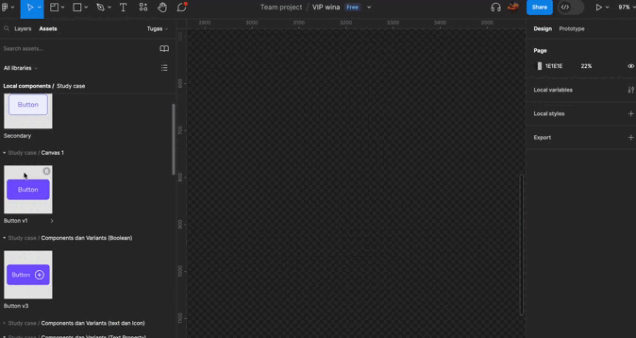
How to Create Boolean and Variants in Figma
1- Create Boolean
Select an Asset
Choose what asset you want to convert to boolean (a button or icon or any element). Detach instance and rename the button.

Slide 9
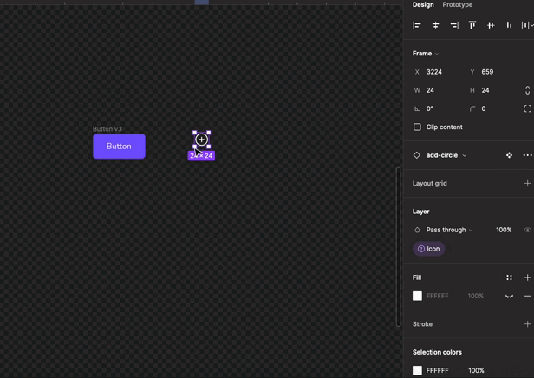
How to Create Boolean and Variants in Figma
2. Add an icon
Select an icon, then click the v3 button and paste the icon into the button. Change the Horizontal resizing into Hug Contents

Slide 10
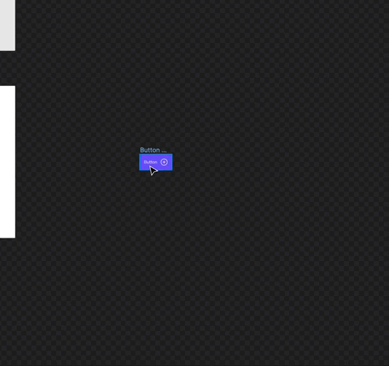
How to Create Boolean and Variants in Figma
3. Duplicate the Button
Duplicate the button Into three Buttons(Default, Secondary, Disable). change the color of each button, Click the button and press I to choose a color. Then block all the button and duplicate that, and press Shift + X to change the Primary into Secondary button.

Slide 11
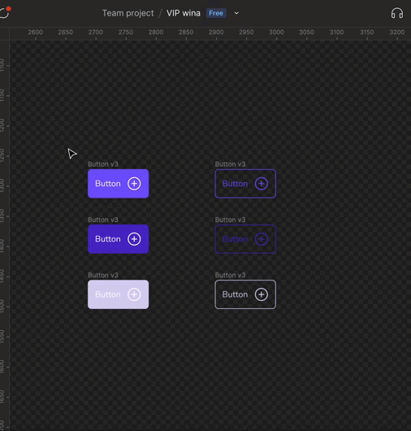
How to Create Boolean and Variants in Figma
4. Make a Component set
Block all Buttons, right-click on it, and from the context menu, select “Create Component” or press the Ctrl + Alt + K (Windows) or Cmd + Option + K (Mac) shortcut. You can also create a component by selecting the element and clicking the “Create Component Set” button in the top-right corner. Then Rename the Component.

Slide 12
How to Create Boolean and Variants in Figma
5. Change the property name
In the right side bar there is a property 1, then change it to type.
Click all buttons Primary and change the Default next to Type into primary. And do the same thing with the secondary button
In the right side bar there is a property then add Variant, change the variant name into State.
Click both the Default button and change the Default next to State into Default(The default doesn’t need to be changed because it is automatic), but Hover and Disable need to change the name. So click both Hover button, change the Default next to Type into Hover. Do the same thing with the Disable button

Slide 13
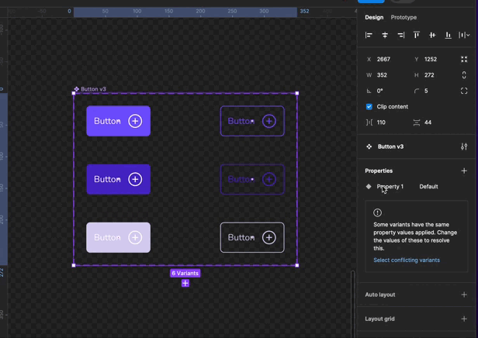
How to Create Boolean and Variants in Figma
5. Change the property name

Slide 14
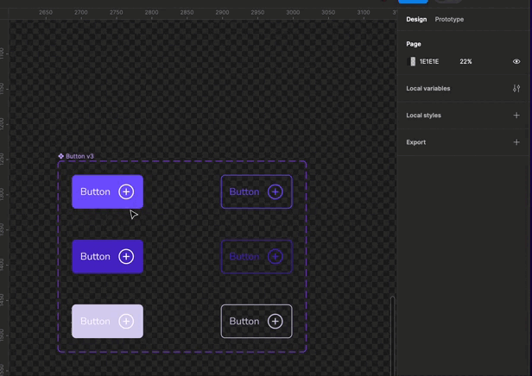
How to Create Boolean and Variants in Figma
6. Create a Boolean
Click the icon inside the button, then click the sign like the arrow below the icon to block all icons. on the right side bar there is a layer then press create boolean property, and named “icon” the condition is true. Do the same thing with the Button Text.

Slide 15
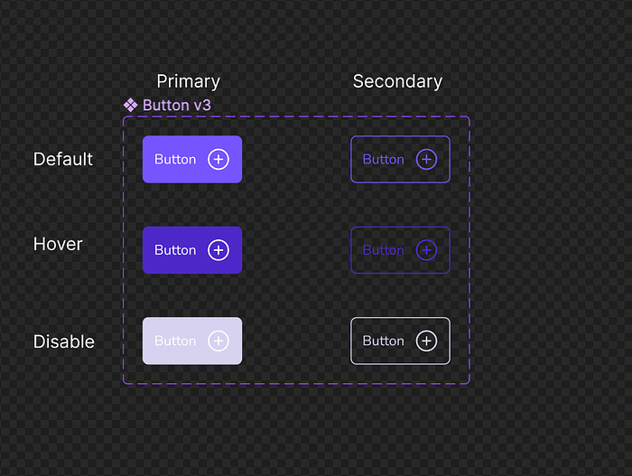
How to Create Boolean and Variants in Figma
7. Give a title to the button
Duplicate some Text, put the text above the Primary and Secondary buttons. give titles for the default, hover, and disable buttons

Slide 16
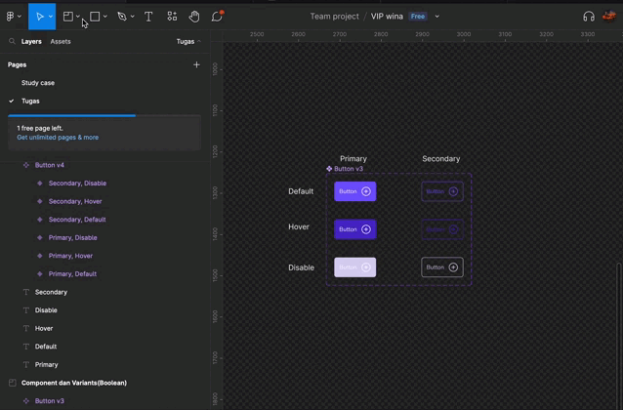
How to Create Boolean and Variants in Figma
8. Create a Section
Click frame in the top right menu, or press F. Then choose section and all the Buttons and the tittles. Give the section a name “Component and Variants (Boolean)”

Slide 17
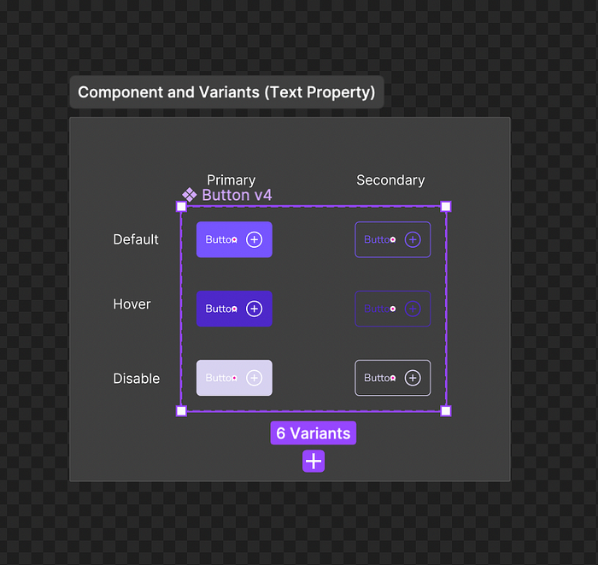
How to Create Boolean and Variants in Figma
Create Text Property
Duplicate the Boolean
Duplicate the boolean section, Rename the section name “Component and Variants (Text Property)”. Then rename Button v3 to Button v4

Slide 18
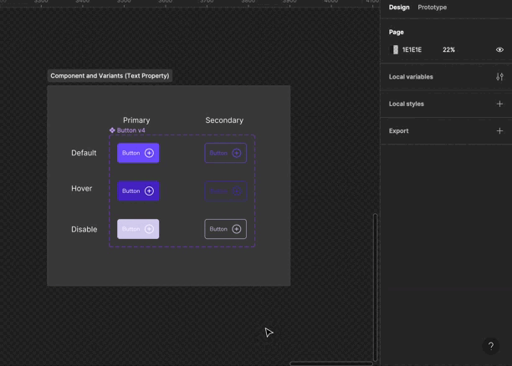
How to Create Boolean and Variants in Figma
2. Create a Text Property
Click the Text inside the button, then click the sign like the arrow below the icon to block all Texts. on the right side bar there is a layer then press create Text property, and Rename it to “Label”.

Slide 19
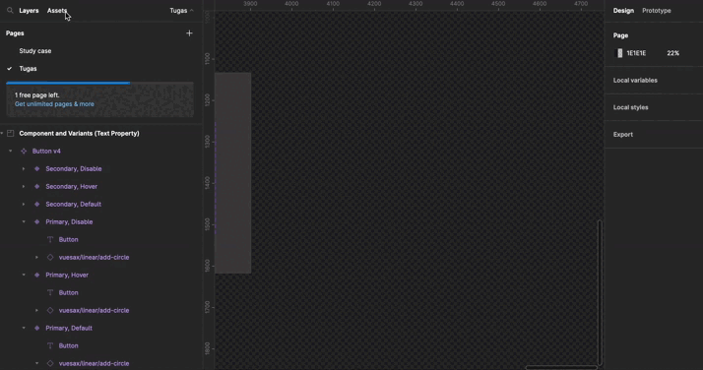
How to Create Boolean and Variants in Figma
3. how to use Text Property
Take the button in assets, then take the button in the text property v4. In the right side bar there is a label then we can change the text in the button

Slide 20
Organizing Project

Slide 21
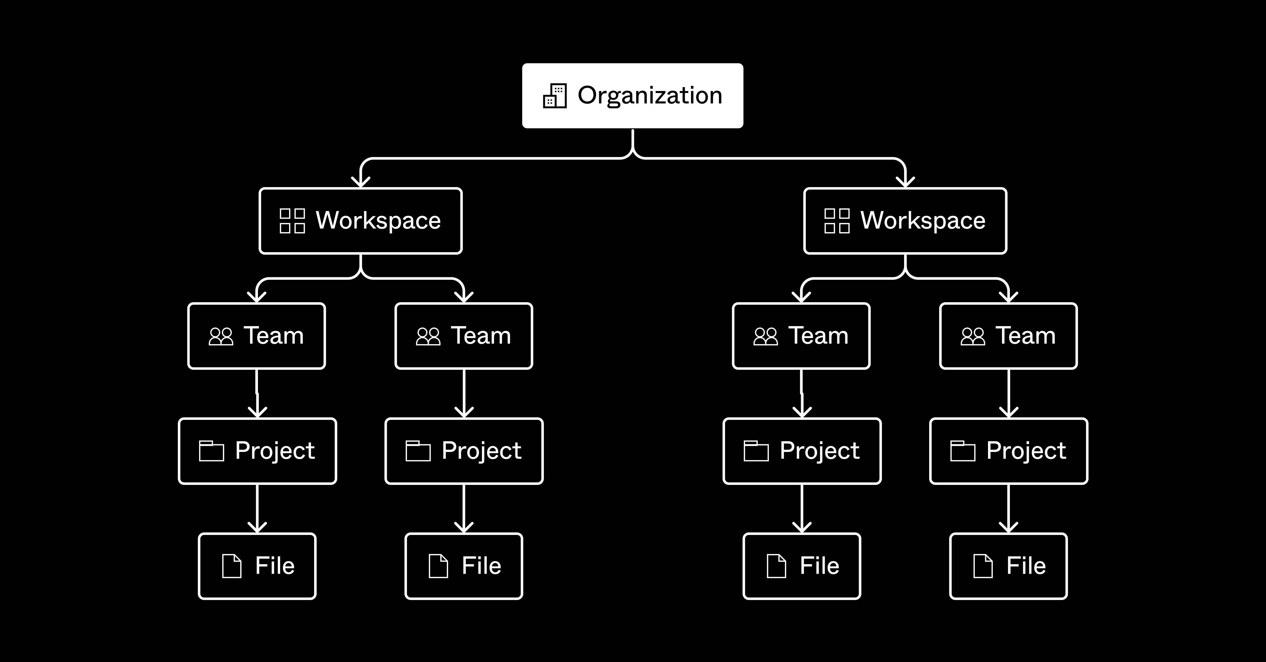
Organizing Project
Organizing your projects in Figma can greatly improve your workflow and collaboration. Here are some best practices to help you get started:
1. Use Teams and Projects
Teams: Create teams for different departments or projects. This helps manage permissions and keep workspaces organized.
Projects: Within each team, create projects to group related files together. For example, you might have separate projects for different features or phases of a product.

Slide 22
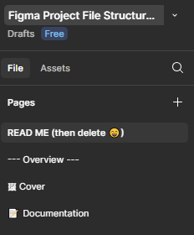
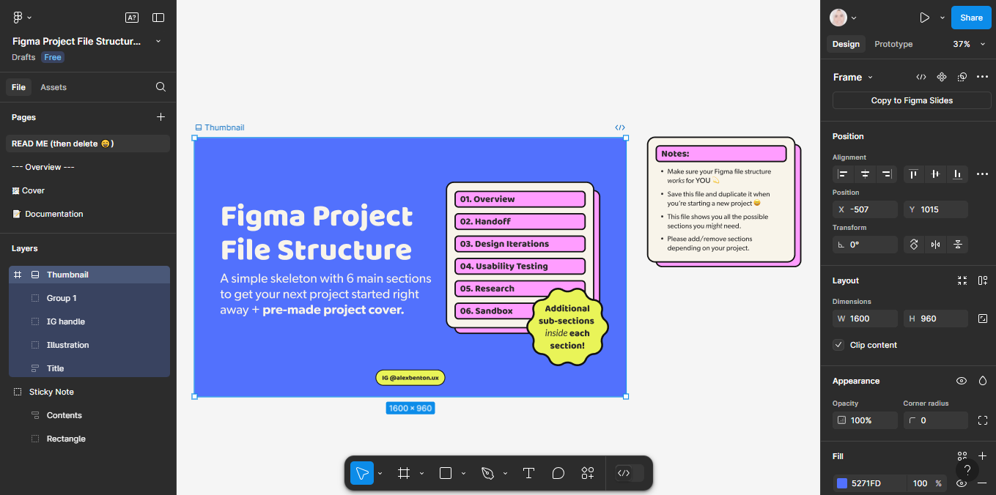
Organizing Project
2. Structure Files and Pages
Files: Use files to separate major sections of your project. Each file can represent a different feature, user flow, or design phase.
Pages: Use pages to organize different aspects of your design within each file. For example, you can have pages for wireframes, high-fidelity designs, and prototypes.

Slide 23
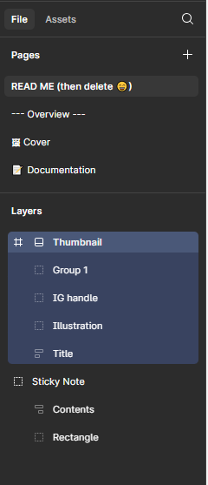
Organizing Project
3. Use Frames and Layers
Frames: Use frames to define the boundaries of your design elements and group related objects together. This makes it easier to manage and navigate your designs.
Layers: Keep your layers organized by naming them clearly and grouping related elements. This helps in maintaining a clean and understandable structure.

Slide 24
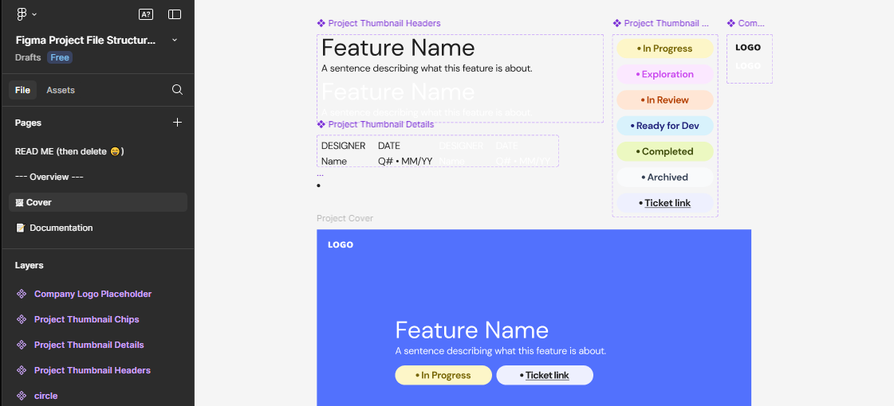
Organizing Project
4. Create Components and Variants
Components: Use components for reusable elements like buttons, icons, and form fields. This ensures consistency across your designs.
Variants: Create variants for different states of a component (e.g., default, hover, active). This helps in managing different versions of a component within a single set.

Slide 25
Organizing Project
5. Use Sections and Annotations
Sections: Divide your designs into sections to create distinct segments for different parts of your project. This is especially useful for handoff to developers.
Annotations: Add annotations to explain design decisions, interactions, and specifications. This helps in communicating your design intent to other team members.
6. Naming Conventions
Consistent Naming: Use consistent naming conventions for files, pages, frames, and layers. This makes it easier to find and understand different parts of your project.
By following these practices, you can create a well-organized and efficient design system in Figma

Slide 26
Thank You

